Slide 1
(Inserts Program Name) Wants YOU! (to do Pro Bono Work) Speaker Location Date
Developed by the
2010-2011 Leadership LSBA Class

Slide 2
Professionalism: Some Guiding Thoughts
The leading rule for the lawyer, as for the man of every other calling, is diligence. Leave nothing for tomorrow which can be done today. – Abraham Lincoln
Any society, any nation, is judged on the basis of how it treats its weakest members—the last, the least, the littlest.
– Cardinal Roger Mahoney

Slide 3
What is Pro Bono service?
LEGAL services which are provided to INDIGENT persons or organizations WITHOUT EXPECTION OF PAYMENT

Slide 4
Pro bono 101:
The Importance of
Pro Bono Work

Slide 5
Pop quiz
The Importance of Pro Bono Work is to:
Improve Access to Justice
Gain Legal Experience
Market Your Practice or Firm
Uphold Our Profession
All of the above

Slide 6
Legal Assistance Is NOT Available to All Persons Equally

Slide 7
What prevents people from accessing legal services?
Poverty has risen to its highest rate in 50 years – today, more than 46 million Americans live below the poverty level.
While those in extreme poverty are clearly unable to afford counsel, many working poor and members of the middle class need pro bono assistance.
Notes:
Could YOU afford to hire YOURSELF in extended litigation?

Slide 8
What prevents people from accessing legal services?
Many don’t know their rights, how to resolve issues through the legal system or how to access the legal system.
Remember, the law is complex and involves a great deal of education, experience and a significant commitment of time.

Slide 9
What about the free legal aid programs?
Legal services organizations work at capacity and lack adequate resources to meet all the need for legal services
Grant restrictions and conflict rules can prohibit many poor people from qualifying for free legal services
One study found that only 50% , of the poor who qualify for legal services, can actually be served by these legal services organizations due to budgetary constraints.

Slide 10
What can we do?
As poverty levels rise, and budgets for legal service programs are cut, the gap between legal need and legal assistance is widening.
We can help close this gap by volunteering our time and expertise to help those in need.

Slide 11
Times are tough, even for attorneys. But consider some additional reasons to get involved:
Pop quiz
Improve Access to Justice
Gain Legal Experience
Market Your Practice or Firm
Uphold Our Profession
All of the above

Slide 12
Pro Bono Service to Gain Legal Experience:
New lawyers can get first-hand experience with clients and litigation.
Lawyers looking for work can bridge the employment gap and build networks
Practicing lawyers can learn new areas of law and public policy issues

Slide 13
Pro Bono Service May Help Market your Practice or Firm:
Pro bono service is a great way to get your name out in the community
Judges, colleagues and community members respect your pro bono service
The legal community takes notice of the lawyers and firms that lead by example

Slide 14
Still not convinced? Consider the duty to . . .
Pop quiz
Improve Access to Justice
Gain Legal Experience
Market Your Practice or Firm
Uphold Our Profession
All of the above

Slide 15
What should we do? Rule of Professional Conduct 6.1
Every lawyer should aspire to provide legal services to those unable to pay. A lawyer should aspire to render at least (50) hours of pro bono publico legal services per year.
In fulfilling this aspirational goal, the lawyer should:

Slide 16
What should we do? Rule of Professional Conduct 6.1
provide a substantial majority of the
(50) hours of legal services without fee or
expectation of fee to:
(1) persons of limited means or
(2) charitable, religious, civic, community, governmental, and educational organizations in matters that are designed primarily to address the needs of persons of limited means; and

Slide 17
What should we do? Rule of Professional Conduct 6.1
(b) provide any additional services through:
(1) delivery of legal services at no fee or substantially reduced fee to individuals, groups, or organizations seeking to protect civil rights, civil liberties and public rights, or
charitable, religious, civic, community, governmental and educational organizations in matters in furtherance of their organizational purposes, where the payment of standard legal fees would significantly deplete the organization's economic resources or would otherwise be inappropriate;
Notes:
Reminder – This is only after a substantial amount of the 50 hours is done to address legal needs of those with limited means or organization primarily addressing needs of persons of limited means

Slide 18
What should we do? Rule of Professional Conduct 6.1
(b) provide any additional services through:
(2) Delivery of legal services at a substantially reduced fee to persons of limited means; or
(3) participation in activities for improving the law, legal system, or the legal profession.
Notes:
Again – the provision of “substantially reduced fee” service is only after a substantial portion of your 50 hours is done without fee.

Slide 19
How are we doing? A look at the numbers:
The Louisiana Bar has more than 21,000 members.
2,002 attorneys (around ten percent) reported 134,789 pro bono hours during the most recent reporting period, an average of 67 hours per reporting lawyer.

Slide 20
How are we doing? A look at the numbers:
The 134,789 pro bono hours reported statewide average to only about 6 hours for each member of the Bar.
Even assuming some pro bono work goes unreported, this falls far short of the 50-hour goal set by Rule 6.1.

Slide 21
How can we do better?

Slide 22
Pop quiz
The Importance of Pro Bono Work is to:
Improve Access to Justice
Gain Legal Experience
Market Your Practice or Firm
Uphold Our Profession
All of the above

Slide 23
Pro bono 101 Graduation
Now that you’ve completed Pro Bono
101, it’s time to set goals, seek out
opportunities, and make some contacts . . .

Slide 24
Pro Bono Goals Each of us can . . .
Take at least one pro bono case a year.
Volunteer regularly at a help desk or legal clinic.

Slide 25
Pro Bono Goals Law firms can . . .
Adopt and promote a pro bono policy within the firm.
Give “billable time” credit for pro bono work.
Recognize and reward lawyers who do pro bono work.

Slide 26
Pro Bono Opportunities You can help with . . .
Adoptions
Grandparent Custody
Abused women and children
Simple Wills
Small Successions
Uncontested Divorces
Veteran’s Issues
And special projects to fit your interests

Slide 27
Pro Bono Contacts
You can find contacts for the pro
bono program in your area at the
LSBA’s website:
www.lsba.org/probono

Slide 28
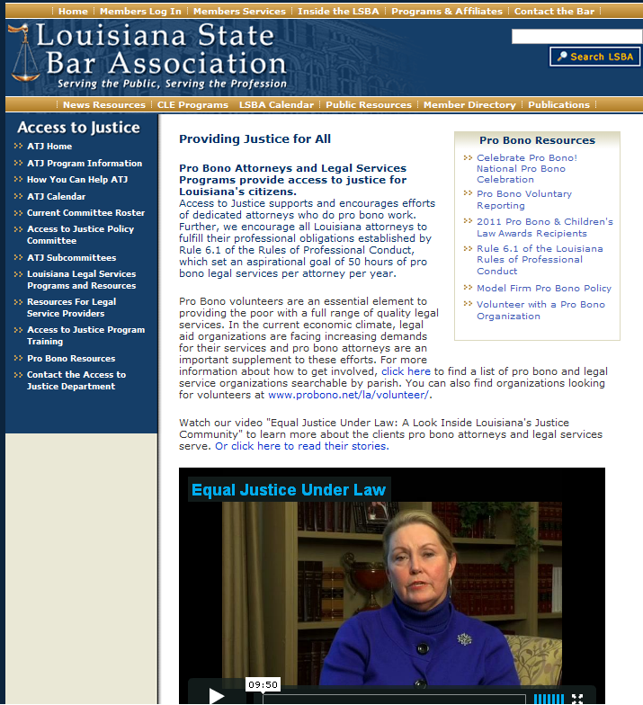
Here You Can Link To . . .
Celebrate Pro Bono Events
Pro Bono Reporting
Pro Bono Awards
Model Firm Pro Bono Policy
Register to Volunteer with a Pro Bono Organization

Slide 29
Your Local Pro Bono Contacts

Slide 30
Thank
You!

