Slide 1
(Insert Organization Name)
Wants YOU!
(to do Pro Bono Work)
Speaker
Location
Date
Developed by the
2010-2011 LSBA Leadership Class
Notes:
Who is pro bono academy

Slide 2
Pro Bono 101:
The Ethics of Pro Bono Work

Slide 3
Pro Bono Ethics:
Some Guiding Principles
In all professional functions a lawyer should be competent, prompt and diligent. . . .
A lawyer should be mindful of the deficiencies in the administration of justice and of the fact that the poor, and sometimes persons who are not poor, cannot afford adequate legal assistance, and should therefore devote professional time and civic influence in their behalf. A lawyer should aid the legal profession in pursuing these objectives and should help the bar regulate itself in the public interest. . . .
ABA Model Rules of Professional Conduct, Preamble, ¶ ¶ 4, 6 (quoted in pertinent part).

Slide 4
Some reasons why Lawyers typically engage in Pro Bono volunteer work:
Improve Access to Justice
Gain Legal Experience
Market a Practice or Firm
Uphold our Profession
All of the above
Notes:
Some reasons may be totally altruistic and some may be totally for self benefitting. Whatever the person reason, the true beneficiary is the client.

Slide 5
Louisiana Rules of
Professional Conduct:
Rule 1.1 Competence
A lawyer shall provide competent representation to a client. Competent representation requires the legal knowledge, skill, thoroughness and preparation reasonably necessary for the representation.
Rule 1.3 Diligence
A lawyer shall act with reasonable diligence and promptness in presenting clients.

Slide 6
Louisiana Rules of
Professional Conduct:
Rule 1.2 Scope of Representation
(b) A lawyer’s representation of a client, including representation by appointment, does not constitute an endorsement of the client’s political, religious, economic, social or moral views or activities.

Slide 7
Louisiana Rules of Professional Conduct:
RULE 1.4. COMMUNICATION
(a) A lawyer shall:
(1) promptly inform the client of any decision or circumstance with respect to which the client’s informed consent, . . .;
(2) reasonably consult with the client about the means by which the client’s objectives are to be accomplished;
(3) keep the client reasonably informed about the status of the matter;
(4) promptly comply with reasonable requests for information; and
(5) consult with the client about any relevant limitation on the lawyer’s conduct when the lawyer knows that the client expects assistance not permitted by the Rules of Professional Conduct or other law.
(b) The lawyer shall give the client sufficient information to participate intelligently in decisions concerning the objectives of the representation and the means by which they are to be pursued.

Slide 8
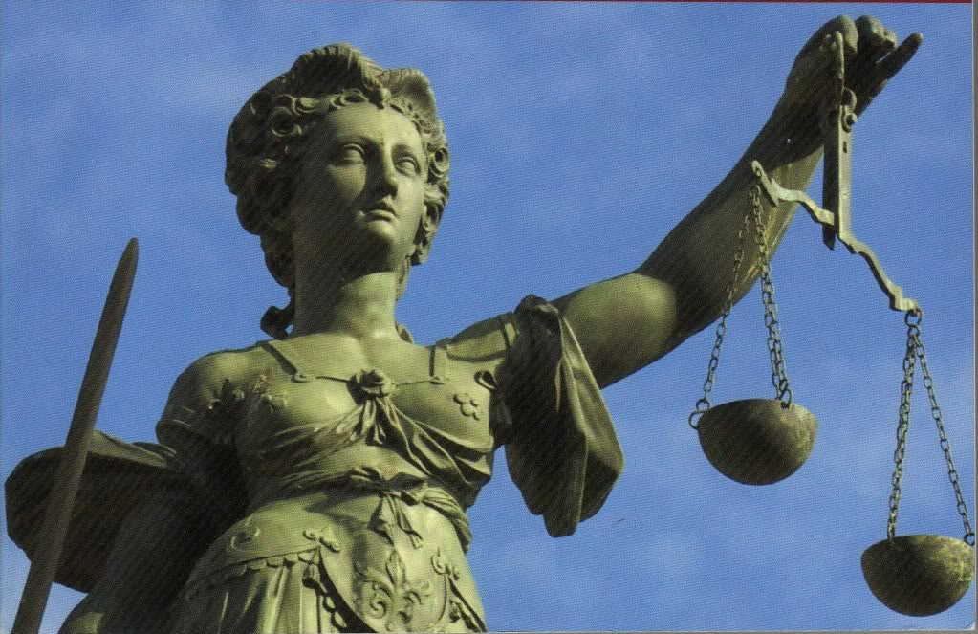
Why SHOULD Attorneys take Pro Bono Cases?
The Law on Pro Bono - Then & Now

Slide 9
Why SHOULD Attorneys Take
Pro Bono Cases?
The Law on Pro Bono Requirements THE EVOLUTION OF THE CURRENT RULE
On July 1, 1970, the LSBA and the
Louisiana Supreme Court replaced the
Canons of Ethics with the Code of
Professional Responsibility.

Slide 10
THE EVOLUTION OF THE CURRENT RULE: the Old School 70’s
In the 1970 version of the Code of
Professional Responsibility, 9 Canons
accompanied by separate provisions
denoted as Ethical Considerations and
Disciplinary Rules were adopted.

Slide 11
THE EVOLUTION OF THE CURRENT RULE: the Old School 70’s
Canon 2 of the 1970 Code of
Professional Responsibility made a
change in the posture toward the legal
profession’s responsibility to make legal
services available to everyone.
Canon 2- “A lawyer should assist the legal profession in fulfilling its duty to make legal counsel available.”

Slide 12
THE EVOLUTION OF THE CURRENT RULE: the Old School 70’s
However, Canon 2 was accompanied
by 33 Ethical Considerations and 10
Disciplinary Rules which tempered the
impact of Canon 2 and the delivery of
Pro Bono services by the members of
the Bar.

Slide 13
THE EVOLUTION OF THE CURRENT RULE: the Old School 70’s
EC2-1 recognized that “[t]he need of members of the public for legal services is met only if they recognize their legal problems, appreciate the importance of seeking assistance, and are able to obtain the services of acceptable legal counsel.”
EC2-2 limited the ability of the profession to address the public’s ignorance of their rights by stating that assistance in allowing the public to recognize their legal problems could come only from the legal profession through educational and public relation programs.

Slide 14
THE EVOLUTION OF THE CURRENT RULE: the Old School 70’s
EC2-3 addressed the propriety of a lawyer volunteering advice, but gave no guidelines whatsoever.
EC2-15 recognized and encouraged the involvement of lawyer referral systems.
EC2-24 & 25 specifically recognized that there are people who need legal assistance, but who are without the means or financial ability to pay.

Slide 15
THE EVOLUTION OF THE CURRENT RULE: the Old School 70’s
DR2-103 was entitled “Recommendation of Professional Employment” and acted to prevent the provision of pro bono services by members of the Bar. DR2-103 addressed the question of providing low-cost or free services in a negative way by limiting the free service approach to “referrals from a lawyer referral service operated, sponsored, or approved by a bar association . . . .”
DR2-103(D) also required a lawyer to cooperate with legal service organizations defined in DR2-103(D), but the lawyer was not allowed to knowingly assist in promoting the use of his own services.
DR2-103(E) provided that a lawyer giving unsolicited advice to a layman was precluded from accepting employment in that matter unless the layman was a close friend, relative, or former client; the advice was in the form of a commercial advertisement or a public speaking event; or in certain class action situations.

Slide 16
THE EVOLUTION OF THE CURRENT RULE : the Radical 80’s
On January 1, 1987, Rules of Professional Conduct, including the initial version of Rule 6.1 became effective.
The rules adopted in Louisiana were an adaptation of the Model Rules of Professional Conduct adopted by the House of Delegates of the ABA in August 1983.

Slide 17
THE EVOLUTION
OF THE CURRENT RULE: the Radical 80’s
Rule 6.1 as it read in 1987 version of the Rules
of Professional Conduct:
A lawyer should render public interest legal service.
A lawyer may discharge this responsibility by providing
professional services at no fee or a reduced fee to persons
of limited means or to public service or charitable groups
or organizations, by service in activities for improving the
law, the legal system or the legal profession, and by
financial support for organizations that provide legal
services to persons of limited means.

Slide 18
THE EVOLUTION
OF THE CURRENT RULE: the Radical 80’s
Rule 6.1 (1987 version)- A lawyer should render public
interest legal service. A lawyer may discharge this
responsibility by providing professional services at no fee or a
reduced fee to persons of limited means or to public Service or
charitable groups or organizations, by service in activities for
improving the law, the legal system or the legal profession, and
by financial support for organizations that provide legal services
To persons of limited means.
This was the first time that the rules governing professional conduct incorporated a special rule addressing Pro Bono service requirements.

Slide 19
THE EVOLUTION
OF THE CURRENT RULE: the Radical 80’s
Rule 6.1 (1987 version)- A lawyer should render public interest
legal service. A lawyer may discharge this responsibility by providing
professional services at no fee or a reduced fee to persons of limited
means or to public Service or charitable groups or organizations, by
service in activities for improving the law, the legal system or the legal
profession, and by financial support for organizations that provide
legal services to persons of limited means.
However, the comments to Rule 6.1 (1987 version) indicated that the “new” Rule 6.1 was suggestive or obligatory and not mandatory. The comments indicated that Rule 6.1 expressed a policy and was “not intended to be enforced through disciplinary action.”

Slide 20
RECAP
Status of Pro Bono Requirements
from the
Old School (1970’s)
to
The Radical ’80’s

Slide 21

Initial environment for Pro Bono service
was harsh. Prior to the institution of the
new pro bono publico requirements in
1970, any cutting of fees was a dangerous
act because it could be deemed to be a
downward deviation from the minimum
fee schedule, which was an act that was
not encouraged.

Slide 22

From mid-1970’s to mid-1987, the will
to require Pro Bono services was
expressed by the rules enacted, but the
mechanism necessary to actually provide
service to the poor and disabled was
lacking.

Slide 23
In 1987, the need for Pro Bono service
was specifically recognized in Rule 6.1,
but there were no parameters provided
for what service attorneys had to provide
and there was no penalty for failure to
address the need.

Slide 24
Current events:
Rule 6.1,
The Current Version

Slide 25
Why SHOULD Attorneys Take
Pro Bono Cases?
The Law on Pro Bono Requirements
Rule 6.1 of the Rules of Professional
Conduct
Current Version was adopted March 1, 2004, and contains the requirement that
attorneys provide Pro Bon Representation.

Slide 26
Why SHOULD Attorneys Take
Pro Bono Cases?
The Law on Pro Bono Requirements
Rule 6.1 of the Rules of Professional Conduct
THE NOW
Every lawyer should aspire to provide legal
services to those unable to pay. A lawyer
should aspire to render at least 50 hours of
pro bono publico services per year.

Slide 27
Rule 6.1 of the Rules of Professional Conduct-
The rule continues with suggestions for how the 50 hours of service should be dedicated
… a substantial majority of the (50) hours should be to service the needs of:
(1) persons of limited means, or
(2) charitable, religious, civic, community, governmental and educational organizations in matters
that are designed primarily to address the needs of persons of
limited means.

Slide 28
Rule 6.1 of the Rules of Professional Conduct-
Rule 6.1 further suggestions other services to provide in addition to the “substantial majority” of the 50 hours as suggested above:
(1) delivery of legal services at no fee or substantially reduced fee to individuals, groups or organizations seeking to secure or protect civil rights, civil liberties, or public rights, or charitable, religious, civic, community, governmental and educational organizations in matters in furtherance of their organizational purpose, where the payment of standard legal fees would significantly deplete the organization’s economic resources or would be otherwise inappropriate;

Slide 29
Rule 6.1 of the Rules of Professional Conduct-
Rule 6.1 further provides that if you cannot provide 50 hours of free legal services, then the obligation can be completed by the:
delivery of legal services at no fee or substantially reduced fee to individuals, groups or organizations seeking to secure or protect civil rights, civil liberties, or public rights, or charitable, religious, civic, community, governmental and educational organizations in matters in furtherance of their organizational purpose, where the payment of standard legal fees would significantly deplete the organization’s economic resources or would be otherwise inappropriate;
(2) delivery of legal services at a substantially reduced fee to persons of limited means, or

Slide 30
Rule 6.1 of the Rules of Professional Conduct-
Rule 6.1 further provides that if you cannot provide 50 hours of free legal services, then the obligation can be completed by the:
(1) delivery of legal services at no fee or substantially reduced fee to individuals, groups or organizations seeking to secure or protect civil rights, civil liberties, or public rights, or charitable, religious, civic, community, governmental and educational organizations in matters in furtherance of their organizational purpose, where the payment of standard legal fees would significantly deplete the organization’s economic resources or would be otherwise inappropriate;
(2) delivery of legal services at a substantially reduced fee to persons of limited means, or
(3) participation in activities for improving the law, legal system or the legal profession.

Slide 31
The current version of Rule 6.1 has set
forth parameters for what is expected of
attorneys with respect to Pro Bono
Service, . . .

Slide 32

But it still has NO TEETH!
There are no penalty
provisions for not providing
Pro Bono services
according to the methods
and means stated in Rule
6.1.

Slide 33

Pencils down
The Importance of Pro Bono Work
is to . . .
Improve Access to Justice
Gain Legal Experience
Market Your Practice or Firm
Uphold Our Profession
All of the above

Slide 34
Pro bono 101
Graduation
Now that you’ve completed Pro
Bono 101, it’s time to set goals,
seek out opportunities, and make
some contacts . . .

Slide 35
Pro Bono Goals Each of us can make . . .
Take at least one pro bono case a year.
Volunteer regularly at a help desk or legal clinic.

Slide 36
Pro Bono Goals Law firms can make . . .
Adopt and promote a pro bono policy within the firm.
Ensure that pro bono work is given credit as “billable time”.
Recognize and reward lawyers who do pro bono work.

Slide 37
Pro Bono Opportunities You can help with . . .
Adoptions
Grandparent Custody
Abused women and children
Simple Wills
Small Successions
Uncontested Divorces
Veteran’s Issues
And special projects to fit your interests

Slide 38
Pro Bono Contacts
You can find contacts for the pro bono
program in your area at the LSBA’s
website:
www.lsba.org/probono

Slide 39
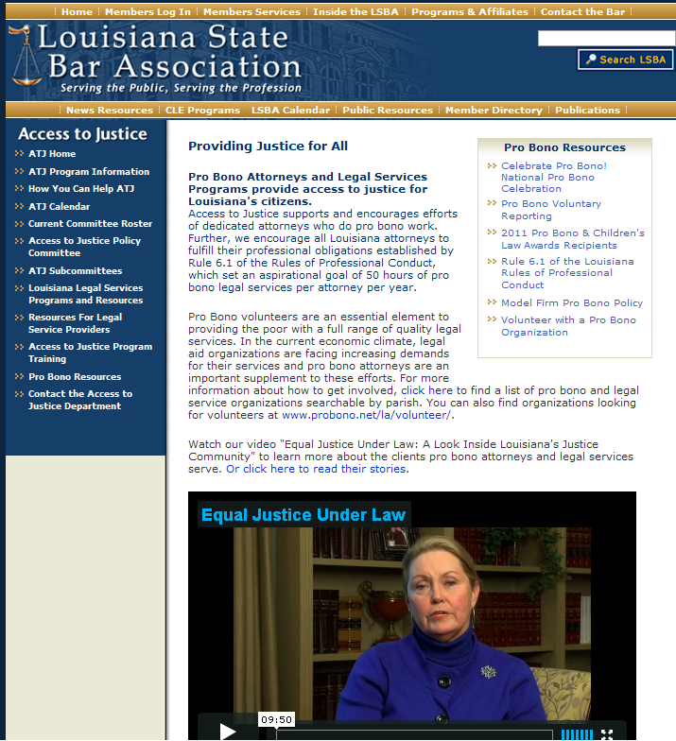
Here You Can Link To . . .
Celebrate Pro Bono Events
Pro Bono Reporting
Pro Bono Awards
Model Firm Pro Bono Policy
Register to Volunteer with a Pro Bono Organization

Slide 40
Your Local Pro Bono Contacts

Slide 41
Thank
You!

