Slide 1





Legal Aid's Innovation Imperative: Building Sustainable Technology to Broaden Legal Access

Slide 2
Outline/moderator questions
INTRODUCTION QUESTION: You're all lawyers in the legal aid space, but at some point, your work evolved to include some element of tech innovation. How did that happen for you?
INNOVATION IN PRACTICE: Can you give us some examples of what leading or supporting innovation has looked like for each of you?
BUILDING A CULTURE OF INNOVATION: How has your organization needed to evolve in order to support innovation?
  If time permits: What resources or partnerships have you found helpful in moving innovation forward at your organization?
FUNDING INNOVATION: What are some of the biggest challenges to funding and sustaining innovation in legal aid?
STRATEGIC PARTNERSHIPS: Are there ways that lawyers in private practice can better support legal aid organizations, especially when it comes to innovation?

Slide 3

THE INNOVATION IMPERATIVE IN LEGAL AID
Legal aid faces structural and cultural challenges: risk aversion, limited capacity, and rigid funding.
With the significant disparity between resources and community needs, innovation is not optional; it’s essential to survival and scale.
Notes:
MODERATOR: introduce session (bullet points above), then ask introduction question; “You're all lawyers in the legal aid space, but at some point, your work evolved to include tech and innovation. How did that happen for each of you?”
PANELISTS: respond/introduce selves
Scheree Gilchrist – Legal Aid of NC: “When I first started in legal aid, I was managing our intake system and trying to solve immediate issues with limited tools. That perspective helped shape the idea of an Innovation Lab — a dedicated space embedded inside Legal Aid of North Carolina where we could rethink service delivery and experiment with bold ideas, both tech and non-tech. Innovation in our world isn’t about gadgets — it’s about giving our teams permission and structure to ask ‘What if?’ and truly test that. Now, with interdisciplinary teammates, curated data, and clear strategic direction, we can think forward without compromising impact.”
Susan StVincent – LAFLA
Scaled innovation across operations, intake, and IT
Integrated LegalServer, data tools, and staff trainings
Champion of iterative process improvements and cross-team collaboration
Innovation embedded in every department — not siloed
Kirra Jarratt

Slide 4

INNOVATION IN PRACTICE
What leading or supporting innovation looks like on the ground
Notes:
MODERATOR: Can you give us some examples of what leading or supporting innovation has looked like for each of you?
PANELISTS: Add slides here to showcase work
Scheree, External Tools:
LIA chatbot (Legal Aid of NC): Developed to address high-intake volumes by democratizing legal information through AI. Goal: Divert advice-only callers and empower early-stage legal understanding. Success hinged on curated, well-maintained resources — not just tech adoption.
Susan, Internal Tools:
LAFLA AI Pilots: AI-generated discovery responses — reducing hours of work to minutes. Case summary generation in LegalServer (for onboarding, pro bono pitches, storytelling).Issue-spotting and outcome tracking for better service and impact metrics. Focus on sustainability: Innovation must be built to last, not just launch. Principle: Not all solutions require AI. Traditional automation (like document assembly) remains invaluable when transparency and control are key.
Kirra, Funding and Collaboration
Funds 50+ orgs through strategic grants and system-building
Created citywide Coordinated Intake & Referral system
Uses trust-based philanthropy to foster experimentation
Supports organizational learning and community-centered design

Slide 5



AI at Legal Aid of North Carolina
Public-Facing Tools
Internal Integration
Everlaw for Good
Lexis+ AI
ChatGPT Team
Querious
MS CoPilot
LIA
LUA
Client Portal
Dialpad AI
Notes:
. We’re using human-centered AI to scale access, enhance service, and reimagine justice.
Lab has always had an internal and external vision so has our strategy for AI deployment:
Public-Facing Tools:
• LIA
• LUA
• Client Portal
• Dialpad AI
Internal Tools:
• Everlaw for Good
• Lexis+ AI
• ChatGPT Team
“We’re using human-centered AI to scale access, enhance service, and reimagine justice.”
NOTE: The portal and dialpad can be both public and internal and external facing

Slide 6


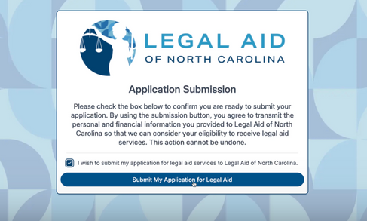


Public-Facing AI Tools
Expanding Access For Clients
LIA (Legal Information Assistant)
  24/7 multilingual chatbot delivering plain-language legal info
  Most used on general LANC, housing, and family law issues
Client Portal
  AI-guided intake and resource navigation
  Offers self-help, voice to text transcription, legal triage, and referrals
Phone System
  Dialpad AI-powered phone system with real-time transcription, translation, summaries, and sentiment analysis
  Enhances client service, captures key legal info, and reduces note-taking burden
  Offers AI playbooks and allows staff to focus more on clients, not on typing
LUA (Legal User Assistant)
  Voice-powered, multilingual intake assistant for low-literacy and rural users
  Expands accessibility for clients unable to type
Notes:
Balance buy vs. build vs. partner
LIA (Legal Information Assistant)
• 24/7 multilingual chatbot delivering plain-language legal info
• Most used on general LANC, housing, and family law issues
. Expanding to concierge for new client portal
LUA (Legal User Assistant)
• Voice-powered, multilingual intake assistant for low-literacy and rural users
• Expands accessibility for clients unable to type
Client Portal
• AI-guided intake and resource navigation
• Offers self-help, voice to text transcription, legal triage, and referrals
Dialpad AI (Helpline + Field Offices)
• AI-powered phone system with real-time transcription, translation, summaries, and sentiment analysis
• Enhances client service, captures key legal info, and reduces note-taking burden
• Offers AI playbooks and Allows staff to focus more on clients, not on typing

Slide 7
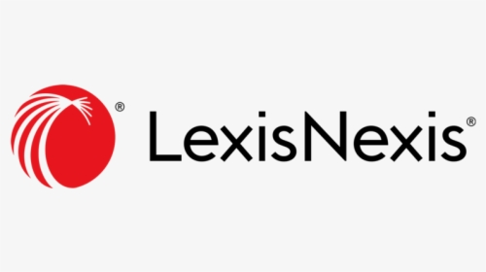






Internal Integration of AI
Everlaw for Good
  Automates document review and issue tagging in litigation
  Reduces burden on litigation teams during discovery
Lexis+ AI (Trial Program)
  Fast, accurate legal research
  Summarizes case law, drafts memos, and checks citation integrity
Supercharging Staff Efficiency
ChatGPT Team
  Secure, private team workspace for AI-assisted drafting, ideation, and administrative tasks
  Used for training, internal tools, grant writing, and strategic planning
Querious Ai (Upcoming)
Joins virtual attorney–client meetings to identify legal issues in real time
Suggests stronger follow-up questions during the conversation
Automatically generates summaries (and billing entries) while preserving confidentiality and reducing admin work
Microsoft CoPilot
  Summarize meetings, extract action items, draft follow-ups in Teams
  Analyze case trends, track metrics, automate tasks in Excel
Notes:
Content:
• AI is helping our legal teams work smarter, faster, and more strategically.
Everlaw for Good:
• Automates document review and issue tagging in litigation
• Reduces burden on litigation teams during discovery
Lexis Protégé
• Fast, accurate legal research
• Summarizes case law, drafts memos, and checks citation integrity
ChatGPT Team:
• Secure, private team workspace for AI-assisted drafting, ideation, and admin tasks
• Used for training, internal tools, grant writing, and strategic planning
Legal Server( TIG with LAFLA) early access due to working group participation and now demo to test. legal Server also spent time with our Lab staff and made some changes to timekeeping : AI-enhanced timekeeping through auto drafting timeslips based on activity in LS such as a case note or calendar event and pre-filling as much info as possible

Slide 8


AI Governance – Doing It the Right Way
AI Review Committee
Ethics & Risk Evaluation
NIST
Framework
Alignment
Key Principles: Transparency, Human Oversight, Equity, UPL Safeguards
Notes:
• We’re building a thoughtful AI governance framework rooted in ethics, security, and justice.AI Governance at LANC Includes:
Key elements:
• AI Review Committee
• Ethics and Risk Evaluation
• NIST Framework alignment
• Key principles like transparency, human oversight, equity, UPL safeguards
• AI Review Committee: Reviews and evaluates new AI tools for risk, value, and mission fit.
• AI Ethics & Risk Reviews by Legal Counsel, IT and Lab: reviews all contracts and AI tools. IT adapts NIST AI Risk Management Framework for legal aid context.
• Security & Confidentiality Protocols: Clear disclaimers, non-PII use, internal SOPs
• Principles We Uphold:
• Transparency
• Non-maleficence
• Human oversight
• Accessibility and equity
• No unauthorized practice of law

Slide 9
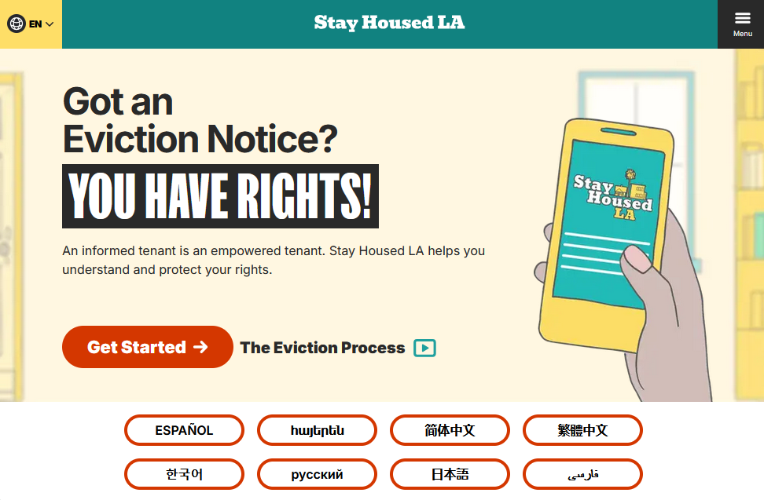
INNOVATION IN PRACTICE AT LAFLA
Expanding Access and Intake
Stay Housed LA Partnership
Online Intake Options
Clinics and Satellites
Call Center
Appointment Scheduling
Notes:
It’s not a new thing to have centralized intake/referral systems, online intake, call centers, or clinics; however, each of these access channels must constantly evolve to meet changing needs and resources more efficiently. Easy for things that were once novel to become the status quo, so have to build in opportunities to re-evaluate whether they are still meeting needs.

Slide 10
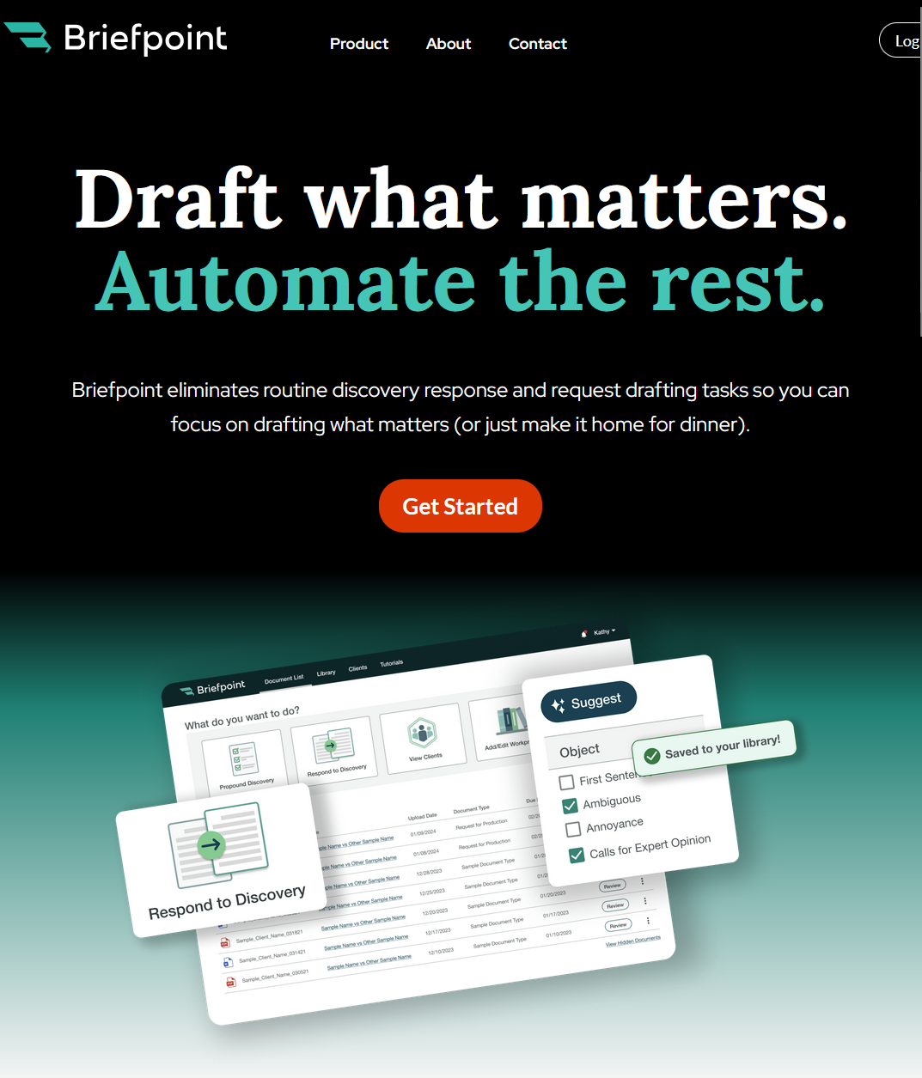
INNOVATION IN PRACTICE AT LAFLA
Empowering Legal Work
Expediting Discovery Responses and Requests with Briefpoint
Embedding AI Tools Into Case Management System
Enabling Text Messaging For Improved Client Communication

Slide 11
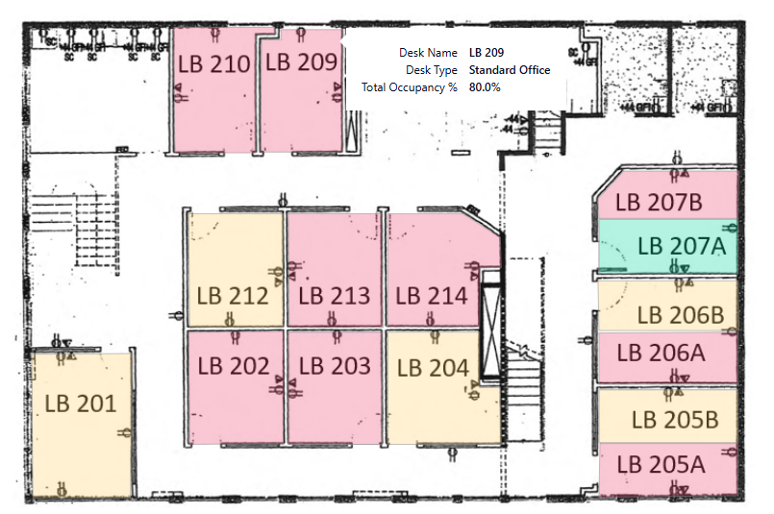
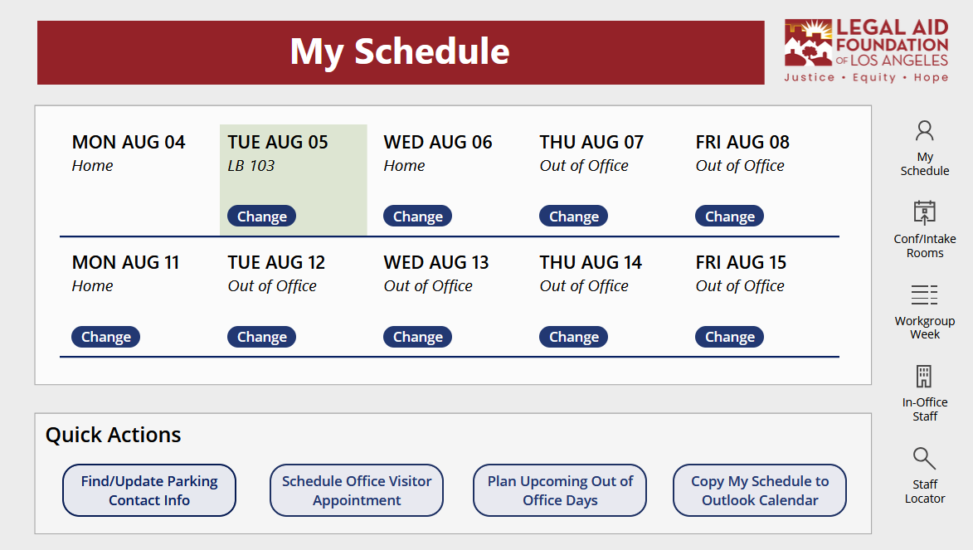
INNOVATION IN PRACTICE AT LAFLA
Reducing Administrative Burdens
Schedule App
Data Dashboards for Timely Evaluation and Analysis
Office Notification System
Automated Compliance Checks / Fund Code
Notes:
Where is everyone (supposed to be)?
How do we make the most of limited office space and manage hybrid schedules?
Are my team members billing their time appropriately?
Is everyone carrying the appropriate caseload per their role/experience?
How do we notify staff in case of emergency at the office?
How can we reduce human error and minimize time spent on manual data review?

Slide 12
INNOVATION IN PRACTICE IN DC
Network Development
  Within legal aid: Single issue networks + Coordinated Intake & Referral / DC Resource Bridge
  And across stakeholders: DC Social Justice Transformations Network
Direct Communication with DC Residents
  Focus groups
  Sentiment analysis (opinion mining)
Data Standardization
Evaluation
  Network Mapping

Slide 13
BUILDING A CUTURE OF INNOVATION
How has your organization needed to evolve in order to support innovation?
Notes:
MODERATOR: How has your organization needed to evolve in order to support innovation?
Scheree Gilchrist – Legal Aid of NC:
Legal aid innovation is born from necessity — but sustained change requires intentional leadership.
Embedding innovation into organizational structure (e.g. Legal Aid NC's dedicated Innovation Lab) ensures:
Strategic experimentation
Space for iterative learning
The ability to elevate promising ideas and scale them
Many programs operate without dedicated innovation roles, relying on team members wearing multiple hats. This limits capacity despite abundant talent.
Susan StVincent – LAFLA: “At LAFLA, innovation often starts with asking: ‘How can this process work better for both staff and clients?’ From managing intake to leading tech operations, I’ve seen how our biggest leaps have come from giving teams space and tools to solve problems creatively — not just top-down directives. By embedding innovation across our departments — data, HR, facilities — we make sure it’s not a siloed function. It becomes part of how we work together.”
Kirra Jarratt “As a funder, you operate one level above program delivery — how do you cultivate a culture of innovation across dozens of grantees, and what role does trust play in that?”

Slide 14
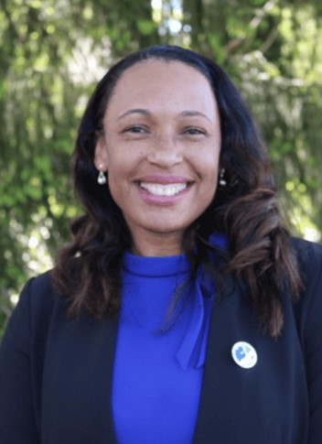
BUILDING A CUTURE OF INNOVATION
Scheree Gilchrist- Chief Innovation Officer, LANC Co-created the Innovation Lab at Legal Aid of NC — a first for legal aid programs nationwide.
" Legal aid innovation is often born of necessity, but lasting change requires structure, intentionality, and committed leadership. Embedding innovation into an organization’s framework—such as Legal Aid NC’s dedicated Innovation Lab—creates the conditions for strategic experimentation, continuous learning, and the ability to elevate and scale promising solutions. In the absence of dedicated innovation roles, many programs depend on staff balancing multiple responsibilities, which limits capacity despite deep talent and creativity.”

Slide 15
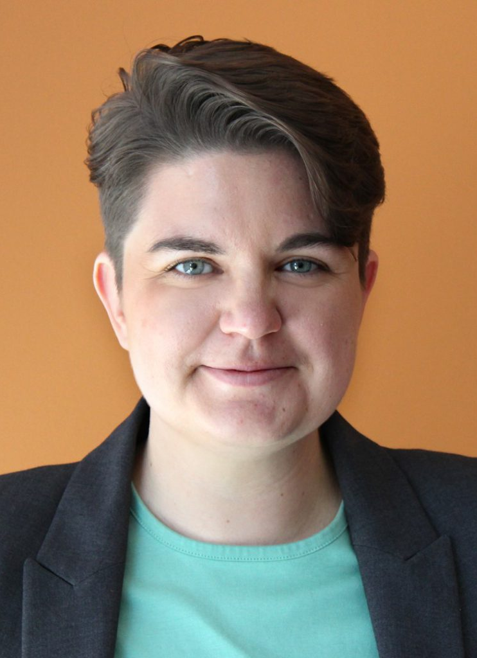
BUILDING A CUTURE OF INNOVATION
Susan StVincent – Chief Operating Officer, LAFLA
“At LAFLA, innovation often starts with asking: ‘How can this process work better for both staff and clients?’ From managing intake to leading tech operations, I’ve seen how our biggest leaps have come from giving teams space and tools to solve problems creatively — not just top-down directives. By embedding innovation across our departments — data, HR, facilities — we make sure it’s not a siloed function. It becomes part of how we work together.”

Slide 16
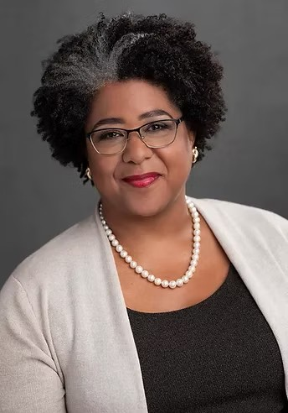
BUILDING A CUTURE OF INNOVATION
Kirra Jarratt- Chief Executive Officer, DC BAR FOUNDATION
“As a funder, we recognized we needed to step into our convening power and create impact beyond our typical grants. Building the DC Resource Bridge -- a coordinated intake system in a city with more than 50 different intakes -- required years of design, stakeholder engagement, community feedback, and investment.”

Slide 17
BUILDING A CULTURE OF INNOVATION IN DC
DC Bar Foundation Background
Founded 1977
Mission: Transform the civil legal aid network, working closely with all stakeholders, so District residents have a fair and equal legal experience
Revenue: private fundraising (66%), IOLTA (32%), public money (3%)
Activities: Grants, LRAP, Training, Systems Change
Culture resulted from:
Vision: What is the news headline 20 years from now?
Strategy: Framework not a Plan
Funding: Funding must be redirected to the future
Commitment: Change does not happen overnight

Slide 18
BUILDING A CULTURE OF INNOVATION IN DC
Current Strategic Framework (Adopted 2019)
Engage all stakeholders in the work
Identify unmet civil legal needs
Infuse racial justice and equity in our work
Fund with intention
Demonstrate that people who need services are getting them

Slide 19
BUILDING A CUTURE OF INNOVATION
Innovation doesn’t require reinventing the wheel — it benefits from refinement, reuse, and shared learning.
Communities like LSNTAP, LSC IT Conference, and Management Information Exchange (MIE) help foster collaboration among legal aid organizations like Legal Aid Foundation of Los Angles (LAFLA) and Legal Aid of North Carolina (LANC).
Funder networks connects national IOLTA (Interest on Lawyer Trust Account) programs and bar foundations.
Innovation doesn’t have to be groundbreaking — it can be iterative, collaborative, and built on what works.

Slide 20
FUNDING & STRATEGIC
INVESTMENT
What are some of the biggest challenges to funding and sustaining innovations in legal aid?

Slide 21
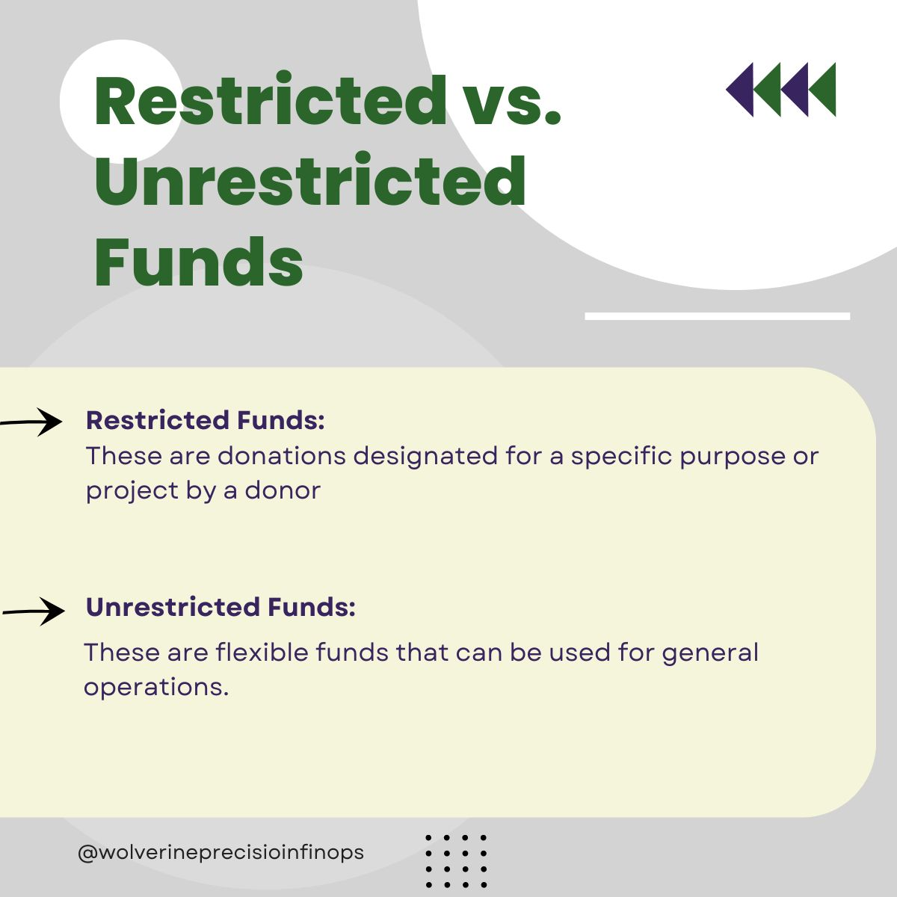
FUNDING & STRATEGIC INVESTMENT
Unrestricted dollars are the lifeblood of innovation.
  Grant funding is often too rigid; truly transformative work happens outside mandated metrics.
IOLTA Funding:
  Critical for innovation, admin, and organizational flexibility.
  Many board members don’t grasp its significance.
  Advocacy from board members and firm allies can help preserve and expand this funding.
Fundraising fatigue: Legal aid leaders are often forced to exhaust energy securing small gifts instead of building scalable solutions. Private partners must understand the long game.
Notes:
Restricted grants limit creativity; true innovation needs flexible funds. IOLTA dollars and private gifts are often the only unrestricted resources, making them disproportionately powerful. Raise awareness: many law firm board members don’t understand how essential IOLTA is — its reduction could collapse smaller legal aid programs. Call to Action: Law firms must be champions — not just financial supporters, but advocates for structural stability and innovation.
Unrestricted dollars = innovation fuel.
IOLTA funding is critical but often misunderstood or under threat (e.g. NC’s legislative freeze).
Law firm board members must understand their role in sustaining innovation — not just donating, but advocating.
DCBF’s Role:
Administers Access to Justice grants, Civil Legal Counsel Projects, and private grants totaling tens of millions annually.
Offers Loan Repayment Assistance Program (LRAP) to retain skilled legal aid attorneys.
LAFLA & LANC:
Use flexible dollars to fund tech pilots, admin infrastructure, and innovation labs.
Emphasize that small gifts can have outsized impact when unrestricted.

Slide 22
PARTNERSHIPS & LONG-TERM
THINKING
Are there ways that lawyers in private practice can better support legal aid organizations, especially when it comes to innovation?
Notes:
MODERATOR: How has your organization needed to evolve in order to support innovation?
Scheree Gilchrist – Legal Aid of NC:
Legal aid innovation is born from necessity — but sustained change requires intentional leadership.
Embedding innovation into organizational structure (e.g. Legal Aid NC's dedicated Innovation Lab) ensures:
Strategic experimentation
Space for iterative learning
The ability to elevate promising ideas and scale them
Many programs operate without dedicated innovation roles, relying on team members wearing multiple hats. This limits capacity despite abundant talent.
Susan Vincent – LAFLA: “At LAFLA, innovation often starts with asking: ‘How can this process work better for both staff and clients?’ From managing intake to leading tech operations, I’ve seen how our biggest leaps have come from giving teams space and tools to solve problems creatively — not just top-down directives. By embedding innovation across our departments — data, HR, facilities — we make sure it’s not a siloed function. It becomes part of how we work together.”
Kirra Jarratt “As a funder, you operate one level above program delivery — how do you cultivate a culture of innovation across dozens of grantees, and what role does trust play in that?”

Slide 23

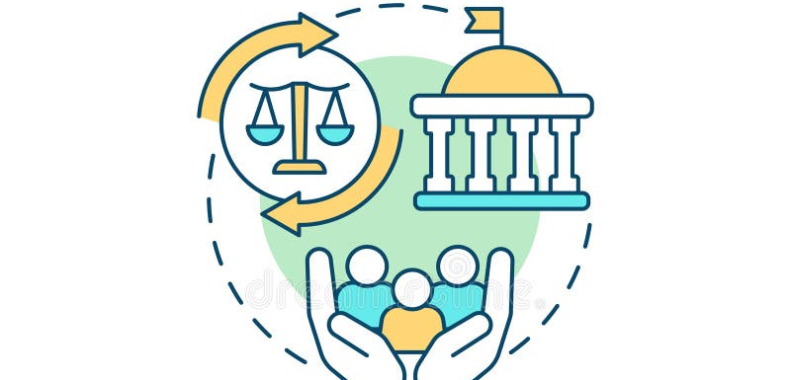
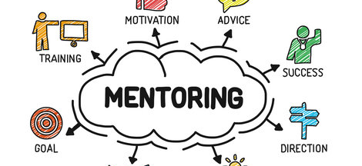
PARTNERSHIPS & LONG-TERM THINKING
What Legal Aid Needs from Law Firm Allies
Board Advocacy
  Board members who champion—not question—innovation
Flexibility in expectations, curiosity about tools
Advocacy for IOLTA and unrestricted funding
Legislative Support
Knowledge Sharing
“We’re not behind the curve. We’re building it.”

Slide 24

PARTNERSHIPS & LONG-TERM THINKING
The Role of Law Firm Board Members
Legal aid teams are not “lesser lawyers.” They are tech-savvy, strategically positioned leaders working at justice’s edge.
Board members should:
  Embrace innovation over legacy assumptions
  Champion flexible funding
  Stay curious and connected to the evolving mission

Slide 25
Q & A

