Slide 1


Slide 2
“Equity-Focused Leadership as a Form of Resistance”
Angela A. Allen-Bell
B. K. Agnihotri Endowed Professor
Southern University Law Center
Post Office Box 9294
Baton Rouge, Louisiana 70813-9294
ABell@sulc.edu

Slide 3


Slide 4
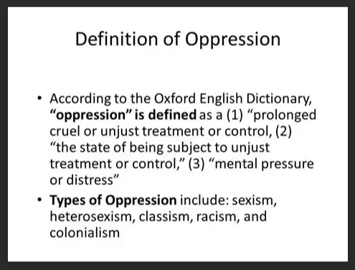

Slide 5
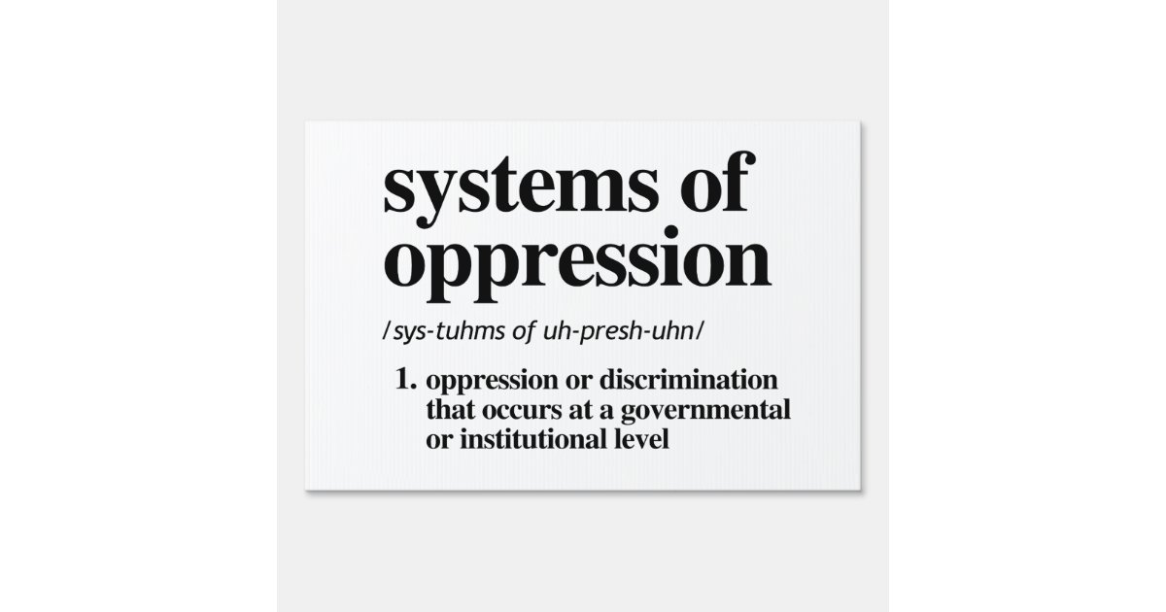

Slide 6
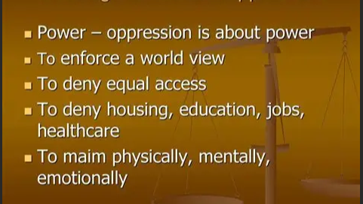

Slide 7
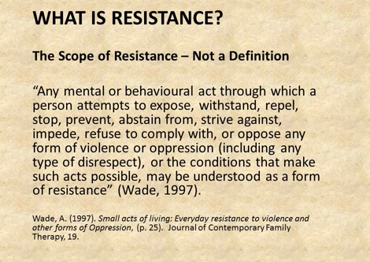

Slide 8
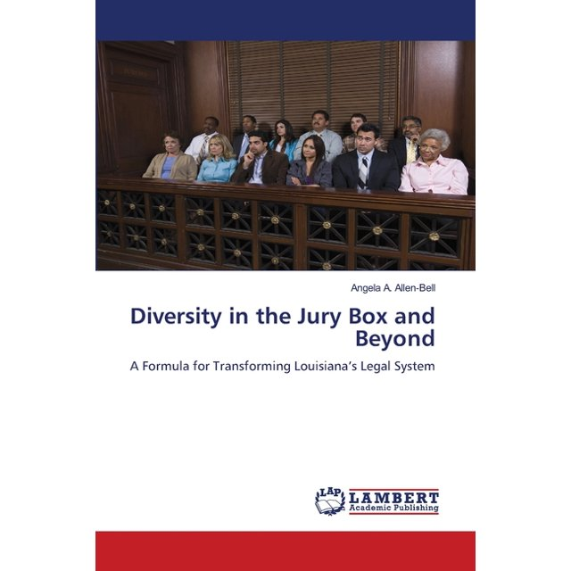

Slide 9


Slide 10
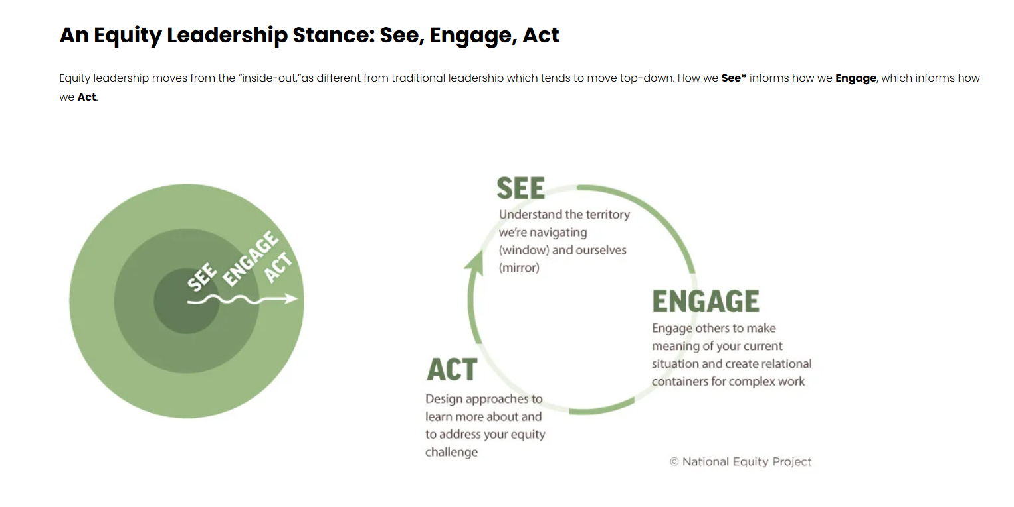

Slide 11
“Equity in the workplace means to intentionally and purposely and consciously ensure that everyone in the company has access to the support, resources, treatment and the opportunities they need to succeed in the workplace.”
-Daniel Herrera

Slide 12
ST. JOHN’S UNIVERSITY SCHOOL OF LAW seeks entry-level and lateral candidates to join our dynamic faculty. We are deeply committed to equity, inclusion, and anti-racism, and are particularly interested in candidates who will enrich the diversity of our faculty. We are open to a variety of teaching and scholarly interests, with particular needs in Torts, Trusts and Estates, Constitutional Law, Civil Rights, Administrative Law, Property, Immigration Law, and Environmental Law.
St. John’s Law School is located in New York City…
*****
In compliance with New York City’s Pay Transparency Act, the annual hire-on rate for entry-level assistant professors is $145,000 - $155,000, plus additional compensation in the form of summer research stipends and supplemental publication awards. Compensation for lateral candidates coming from faculty positions at other law schools is commensurate with the candidate’s experience. St. John's considers factors such as (but not limited to) scope and responsibilities of the position, candidate's work experience, education/training, key skills, and internal peer equity, as well as market and organizational considerations.

Slide 13


Slide 14
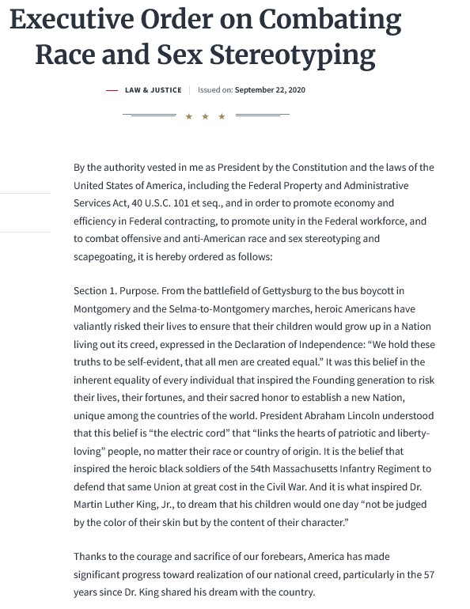

Slide 15
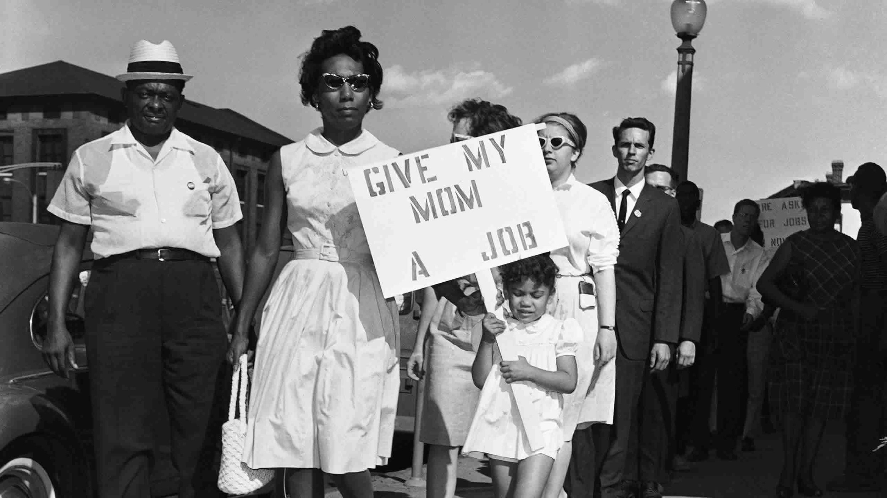

Slide 16
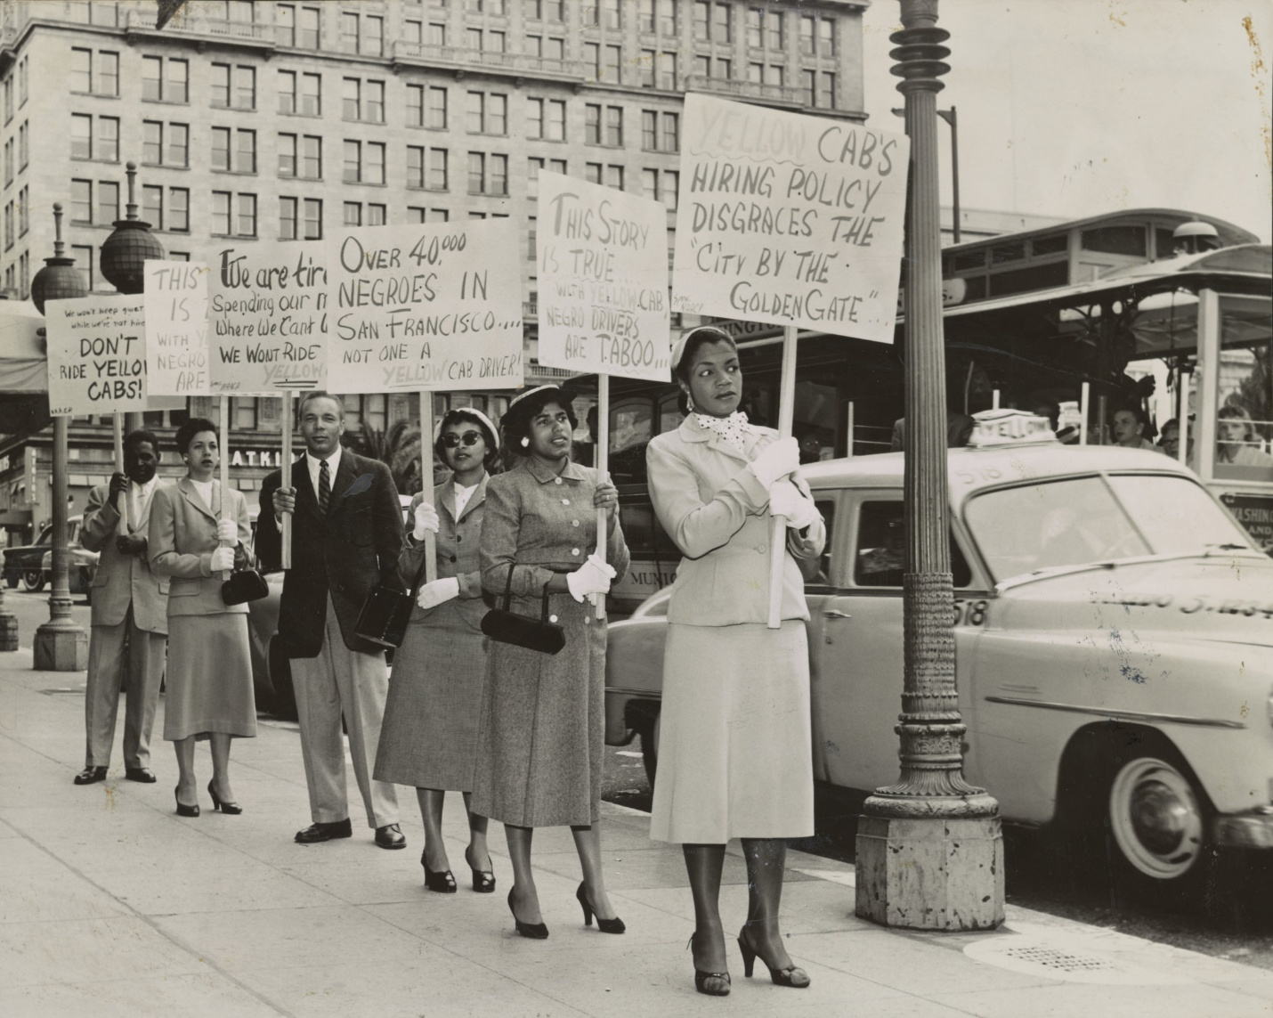

Slide 17


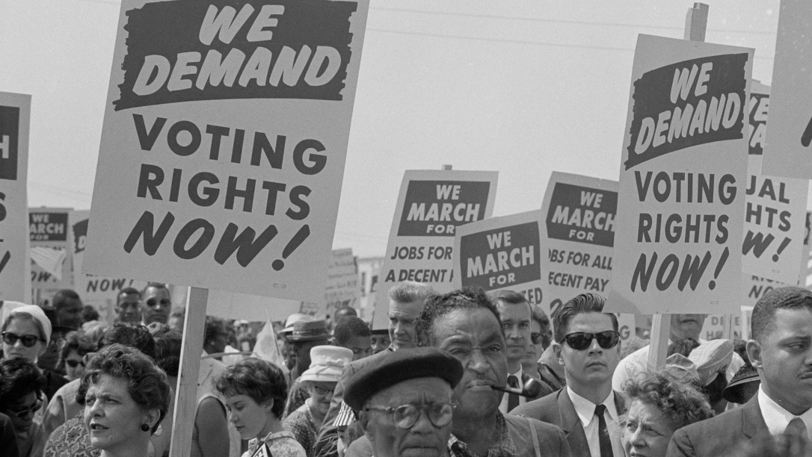


Slide 18

THE DEI COUNTERNARRATIVE
U.S. Constitution (Effective 1788)
Thirteenth Amendment (Ratified in 1865)
Civil Rights Act of 1866
Civil Rights Act of 1871
Civil Rights Act of 1957
Civil Rights Act of 1964
Voting Rights Act of 1965
Civil Rights Act of 1968
Civil Rights Act of 1991

Slide 19


Slide 20
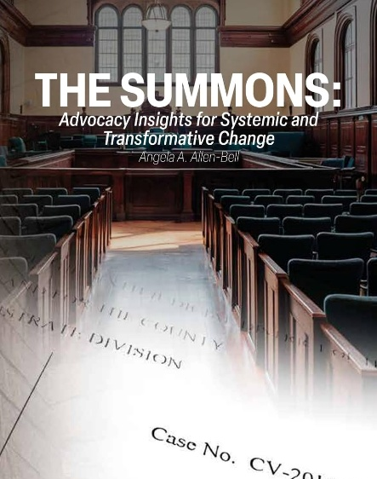
“A leader desires a change that can be accomplished in a season whereas the revolutionary measures victory in incremental terms and is prepared to wait for cumulative gains to ferment over time. In the interim the revolutionary does his or her best to redefine what is normal.
The revolutionary continuously causes a shift in what the public once thought was the best that man could achieve and the revolutionary makes it uncomfortable for his contenders to function by breathing the stifling air of mediocrity.
The appetite of a revolutionary is quenched by evidence of a struggle. The recognition of time as a reservoir of rectitude sustains them….”

Slide 21
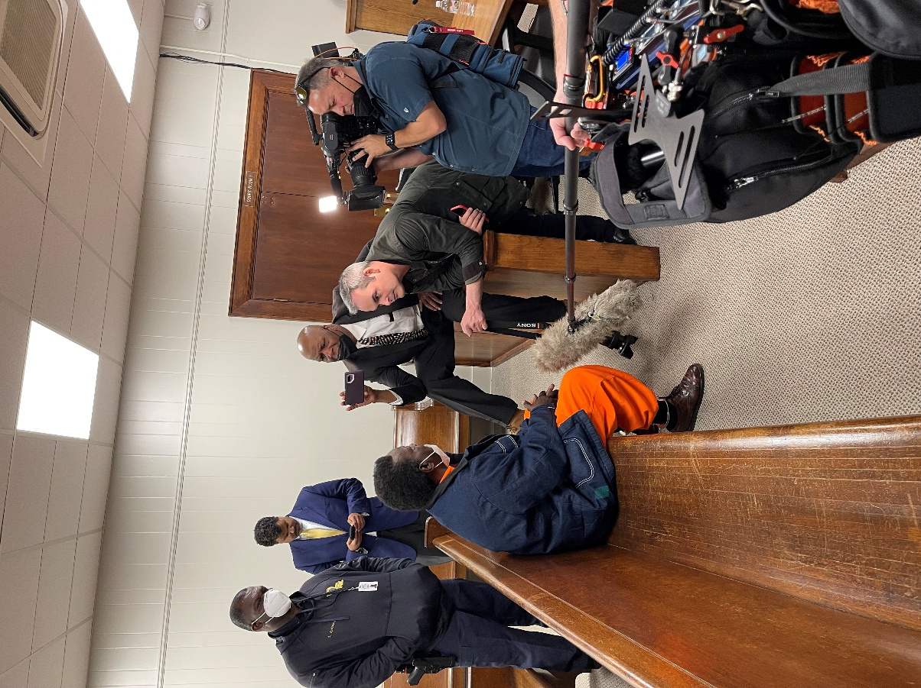

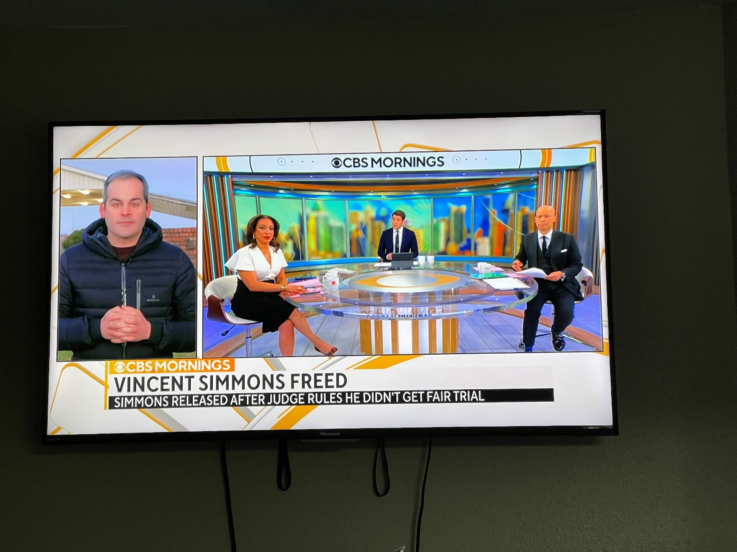

Slide 22



Slide 23


