Slide 1
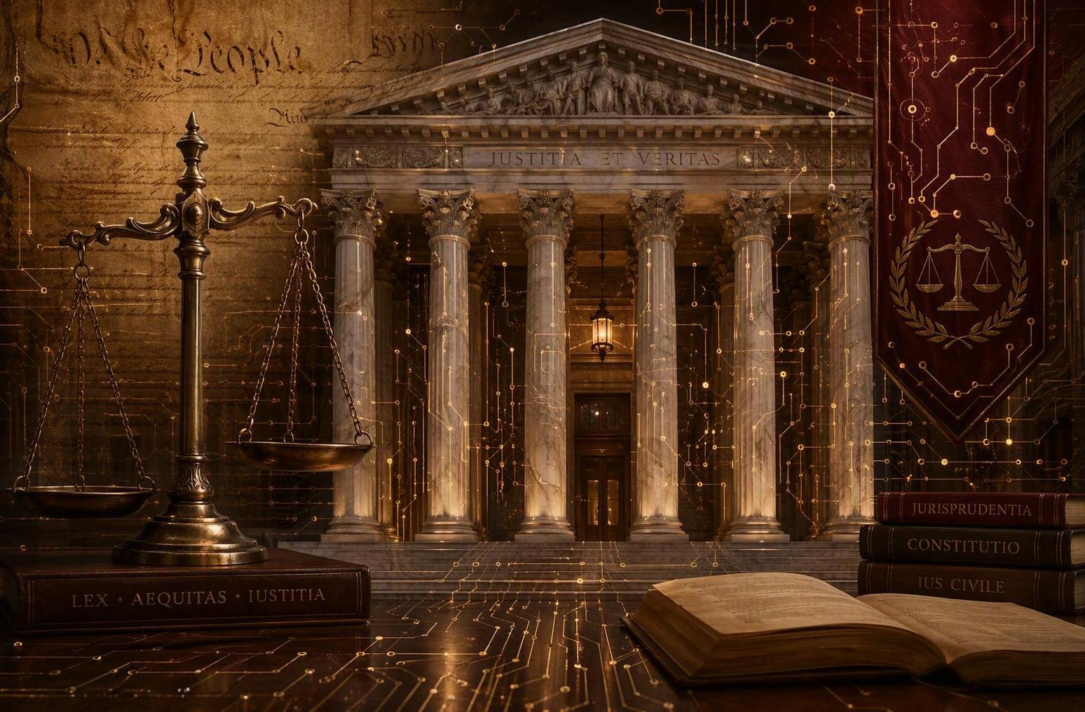
CONTINUING LEGAL EDUCATION
Artificial Intelligence in Legal Practice
Tools, Ethics, and Accountability with a Louisiana Focus
A practical guide for new and experienced attorneys

Slide 2










ROADMAP
What We Will Cover Today
1. AI Tools for Lawyers
2. Accuracy & Reliability
3. Confidentiality
Research, drafting, and review platforms
Hallucinations and why they happen
Protecting privilege and client data
4. Rules of Professional Conduct
5. Louisiana Regulations
6. AI Governance
ABA Model Rules & ABA Opinion 512
Supreme Court guidance & Act 250
Building firm-level policies
7. Court Standing Orders
8. Human Oversight
9. Sanctions & Discipline
Disclosure & certification rules
Verify before you file
Real cases, including Louisiana
AI in Legal Practice | Louisiana CLE
2

Slide 3
FOUNDATIONS
What Is AI — and Generative AI?
Artificial Intelligence (AI)
Generative AI
Computer systems that perform tasks normally requiring human intelligence such as recognizing patterns, making predictions, and processing language.
Learns from large amounts of data instead of following fixed rules.
Has powered legal research, document review, and e-discovery tools.
Usually “narrow” and built for specific tasks, not general reasoning.
A type of AI that creates new content such as text, images, or code, by predicting the most likely next words from patterns in its training data.
Powers large language models such as ChatGPT, Claude, and Copilot.
Drafts, summarizes, and answers questions in natural language.
Predicts plausible text, so it can sound confident yet be wrong (“hallucinations”).
Agentic AI
Agentic AI can autonomously set goals, make plans, and execute process/objective without human intervention or input.
AI in Legal Practice | Louisiana CLE
3

Slide 4




WHY THIS MATTERS
AI Has Already Entered the Practice of Law
Generative AI is now embedded in the tools lawyers use every day — research platforms, word processors, and video conferencing. The question is no longer whether to engage with it, but how to do so competently and ethically.
79%
$1.45B
1,600+
44%
of legal professionals report using AI in some form (2025)
estimated size of the legal-AI market (2024)
court filings with AI errors logged across 35 countries (since 2023)
of firms have no formal AI governance policy (2025)
Sources: Clio Legal Trends; Stanford HAI; Damien Charlotin AI-hallucination database; industry estimates.
AI in Legal Practice | Louisiana CLE
3

Slide 5



THE TOOLBOX
AI Tools Available to Lawyers
Westlaw / CoCounsel
Lexis+ with Protégé
Harvey AI
Thomson Reuters
LexisNexis
Built for law firms (OpenAI-backed)
Conversational research across Westlaw & Practical Law
Document review, deposition prep, timeline building
KeyCite citation verification
CoCounsel now serves approximately 1M professionals in 107 countries
Agentic assistant can draft transactional documents, motions, briefs & complaints
Summarizes documents up to 300 pages
AI-enhanced Shepard’s Citations
Secure Research Vault for firm content
Connects to a firm’s internal knowledge base
Top performer in the 2025 Vals AI benchmark
Scored 94.8% on the benchmark’s Document Q&A task (2025)
Viewed as best suited to litigation-heavy practices
Claude (Anthropic)
eDiscovery AI Tools
General-purpose assistant for drafting, summarizing, and analyzing documents. Enterprise and Team plans offer no data retention and no training on your data.
Relativity aiR, Everlaw, DISCO, and Reveal include AI-assisted document review, privilege screening, and predictive coding capabilities for litigation.
Other tools in the market: Casetext, vLex Vincent AI, Spellbook, Briefpoint.ai. Product capabilities current as of early 2026.
AI in Legal Practice | Louisiana CLE
4

Slide 6

ACCURACY & RELIABILITY
Hallucinations Are A Significant Risk
A “hallucination” is output that sounds right rather than is right — fabricated cases, distorted holdings, or invented quotations delivered with total confidence.
General-Purpose Models (Stanford, 2024)
Legal Research Tools (Stanford, 2025)
Tested on 800,000+ verifiable legal questions:
GPT-4 — 58% hallucination rate
GPT-3.5 — 69%
Llama 2 — 88%
Models often lack awareness of their own errors.
Even “hallucination-free” RAG products err:
Lexis+ AI — wrong >1 in 6 answers (17%+)
Westlaw AI-Assisted — wrong >1 in 3 (>34%%+)
Sources: Stanford RegLab/HAI, “Large Legal Fictions” (2024) and “Hallucination-Free?” J. Empirical Legal Studies (2025).
AI in Legal Practice | Louisiana CLE
5

Slide 7



KNOW THE SIGNS
Anatomy of an AI Hallucination
Fabricated authority
Distorted holdings
Falsified procedure
Confident delivery
Entirely invented case names, citations, or statutes that do not exist.
Real cases cited for propositions they never stand for, or fake quotations.
Made-up docket numbers, courts, dates, or procedural history.
Errors presented fluently — the tool may even ‘confirm’ fakes are real.
“The lawyer’s obligation is crystal clear: read the law you cite. Read the Code. Read the cases… This is an easily preventable problem.”
— Louisiana Fifth Circuit Court of Appeal, In re Sanctions Order of Kenney (2025)
AI in Legal Practice | Louisiana CLE
6

Slide 8

CLIENT CONFIDENTIALITY
What You Type Into AI May Not Stay Private
The Risks
The Safeguards
Consumer tools may train on your inputs, exposing privileged data.
“Shadow AI”: lawyers using free AI tools or chatbots on personal devices, with no employer/firm control or visibility.
Entering client facts into a public tool can risk waiving attorney-client privilege.
In U.S. v. Heppner (S.D.N.Y. 2026), documents a client made with a public AI tool were held not privileged.
Use enterprise AI with a private, isolated data instance.
Review and negotiate contracts, terms and conditions, applicable policies
Anticipate changes in services
Audit security measures
Require confirmation of data deletion
Review clients’ outside counsel guidelines if counsel, implement such guidelines as clients
Obtain informed client consent where appropriate (La. Rule 1.6).
AI in Legal Practice | Louisiana CLE
7

Slide 9
RULES OF PROFESSIONAL CONDUCT
How the Existing Rules Apply to AI
No new rules were needed — the Model Rules (and Louisiana’s mirror rules) already govern AI use.
Rule
Competence
Rule
Confidentiality
Rule
Communication
1.1
1.6
1.4
Maintain tech competence; understand AI’s benefits and risks (Comment 8).
Protect client information entered into any AI tool.
Consult clients about the means used to deliver services under certain circumstances.
Rule
Fees
Rule
Candor to Tribunal
Rule
Supervision
1.5
3.3
5.1 / 5.3
Bill only for time actually spent, AI efficiencies must be reasonable.
Never file fake AI-generated citations; correct errors promptly.
Supervise AI like any nonlawyer assistant — lawyers and staff alike.
AI in Legal Practice | Louisiana CLE
8

Slide 10


NATIONAL GUIDANCE
ABA Formal Opinion 512
Key Takeaways for Practitioners
July 29, 2024
Lawyers must fully consider applicable ethical duties before using GenAI: competence, confidentiality, communication, candor, supervision, and fees.
A self-learning tool that trains on inputs can threaten confidentiality so evaluate the tool before entering client data.
Output must be independently verified by a human, competence is not delegable to a machine.
Be mindful of billing restrictions.
Determine disclosure obligations
Many states have followed: California, Florida (Op. 24-1), Texas (Op. 705), and New York have issued their own AI guidance.
The ABA’s first formal ethics opinion on generative AI
Issued by the Standing Committee on Ethics & Professional Responsibility
AI in Legal Practice | Louisiana CLE
9

Slide 11

LOUISIANA FOCUS
The Louisiana Supreme Court’s Position
“The rules governing the bench and the Bar are not new… they are robust and broad enough to cover the landscape of issues presented by AI.”
— Louisiana Supreme Court, letter to the LSBA, January 22, 2024
Rules the Court Cited
Related Formal Guidance
La. Rules of Prof. Conduct 1.1, 1.3, 1.4, 1.6, 1.15, 3.1, 3.3 & 5.3
La. Code of Civil Procedure arts. 371 & 863
Code of Judicial Conduct Canons 1, 2 & 3 for judges
LSBA Public Opinion 19-RPCC-021 (2019) on technology competence.
Lawyers must understand the privacy policy and terms of service of any platform handling client data, including AI.
AI in Legal Practice | Louisiana CLE
10

Slide 12



LOUISIANA FOCUS
Louisiana Act 250
As the only U.S. civil-law (Napoleonic Code) state, Louisiana codified its AI duties rather than relying solely on a bar opinion.
La. C.C.P. art. 371(C)
Court Technology Guidance
Enacted by Act 250 · Effective August 1, 2025
The Louisiana Supreme Court Technology Commission issued Generative AI Guidelines for judges (October 2025) to govern AI use on the bench.
Attorneys must use reasonable diligence
to verify the authenticity of evidence.
A violation occurs where a lawyer “knew or should have known” evidence was false or AI-manipulated and offered it without disclosure (knowing or reckless submission).
What This Means for You
Use AI s a supplemental tool
Keep a written AI-use policy and if necessary, a log.
Conduct vendor due diligence for any AI tool.
AI obligations now have a statutory backbone in Louisiana.
AI in Legal Practice | Louisiana CLE
11

Slide 13
FIRM POLICY
Building an AI Governance Framework
Blanket bans fail — they create “Shadow AI.” AI is already in Westlaw, Lexis+, and Microsoft 365. Adopt guardrails, not prohibition.
Data Security
Vendor Diligence
Verification Standards
Written Policy
Role-based access controls; secure, compliant environments; protect privileged data.
Vet tools for security, data retention and data flow, and legal compliance before adoption.
A clear, approved AI-use policy that accounts for real world usage, disclosure and compliance enforcement.
Mandate human review of every AI output and keep necessary documentation.
Model in practice: the New Orleans City Attorney’s office adopted an AI policy (effective March 27, 2026) requiring disclosure of prior AI use and annual certification of compliance.
AI in Legal Practice | Louisiana CLE
12

Slide 14

THE COURTROOM
Court Standing Orders on AI (estimates, constantly evolving)
39
113
82
10
federal judges had issued AI standing orders by April 2025
active court orders bind attorney filings on AI use
of those orders require AI disclosure or verification
orders prohibit generative AI use outright
The Original Standing Order
In May 2023, Judge Brantley Starr (N.D. Tex.) issued one of the first orders requiring every filer to certify that no portion was drafted by generative AI or that a human checked any AI-generated content for accuracy. The trend is now shifting from standing orders toward direct sanctions.
Sources: Bloomberg Law (Apr. 2025); Legal AI Governance court-orders tracker. The Fifth Circuit declined to adopt a special AI brief-drafting rule (2024).
AI in Legal Practice | Louisiana CLE
13

Slide 15
THE BOTTOM LINE
Human Oversight Is Non-Delegable
The standard has shifted from “trust but verify” to “do not trust until verified.”
AI Is an Assistant, Not a Lawyer
Signature-Block Accountability
Treat AI output like a junior associate’s draft. It is useful but never file work product without human verification.
Independently read and verify every case, statute, rule, and quotation.
Apply your own professional judgment to finalize all work.
The lawyer who signs the filing owns its accuracy, regardless of delegation or reliance on AI.
Courts sanction supervising, lead, and local counsel, not just the drafter.
Even federal judges have had to withdraw AI-tainted rulings (2025).
AI in Legal Practice | Louisiana CLE
14

Slide 16

SANCTIONS: THE LANDMARK
Mata v. Avianca, Inc.
678 F. Supp. 3d 443
What Happened
S.D.N.Y. · June 22, 2023
Judge P. Kevin Castel
Counsel used ChatGPT to draft a brief opposing dismissal. It fabricated six judicial opinions: Varghese, Shaboon, Petersen, Martinez, Durden, and Miller.
When challenged, the lawyers submitted fake “copies” the tool assured them were real on Westlaw and LexisNexis.
$5,000
The Lesson
Rule 11 sanction against both attorneys
Judge Castel found subjective bad faith — driven less by the original error than by the cover-up. The analysis was called “gibberish,” and the case dismissed.
AI in Legal Practice | Louisiana CLE
15

Slide 17
LOUISIANA SANCTIONS SPOTLIGHT
Hallucinations In New Orleans
Gentry v. Thompson
E.D. La., No. 25-1260 · Judge Carl J. Barbier · Reported sanctions order, March 20, 2026
What Happened
The Consequences
As reported, a City of New Orleans motion to dismiss contained nine nonexistent “hallucinated” case citations.
An Assistant City Attorney started on Westlaw, “resorted to ChatGPT,” and never read or verified the nine cases.
His supervisor reviewed the brief but did not question the suspicious formatting.
Reported Rule 11 sanctions: $250 against the ChatGPT user, $1,000 against the supervising attorney.
Reportedly, a formal admonition to the City Attorney’s office; both attorneys resigned.
The office adopted a written generative-AI policy effective March 27, 2026.
AI in Legal Practice | Louisiana CLE
16

Slide 18
LOUISIANA SANCTIONS SPOTLIGHT
Louisiana Courts Are Watching
In re Kenney
Brooks v. Lowes Home Centers LLC
Walker & Fletcher
La. 5th Cir. · Oct. 2025
W.D. La. 2026 · Judge Jerry Edwards Jr.
E.D. La. & 5th Cir. · Feb. 2026
Court affirmed sanctions against a lawyer who cited nonexistent cases generated by Google, ChatGPT and Copilot. Required to attend 3 hours of CLE training on ethical use of Generative AI and to provide certificate of completion to the Court. Also reported to Louisiana Attorney Disciplinary Board. Taxed with costs of proceedings.
Counsel used Claude to draft a motion and several quotes were fabricated. Clerk discovered hallucinated quotations but attorney entrusted Claude to correct them. Court imposed $1,000 fine, three-hour AI course, and requirement that lawyer will have “a human with a law degree” perform final check of every citation or quotation before filing briefs with the court.
Two separate incidents involving AI hallucinations in briefs. Court imposed $1,000/$2,500 fines, two-hour coursework in generative AI for lawyers.
Several Louisiana matters are drawn from court trackers and press reports — confirm primary citations before relying on them in a filing.
AI in Legal Practice | Louisiana CLE
17

Slide 19
BEYOND LOUISIANA
A National Pattern of Discipline
Case
Court / Year
Outcome
Park v. Kim
2d Cir., 2024
Attorney faced discipline for citing fabricated AI-generated authority from ChatGPT. Attorney referred to Grievance Panel and ordered that a copy of the sanctions order be furnished to client.
Kruse v. Karlan
Mo. Ct. App., 2024
Pro se appeal dismissed for multiple rule violations, including that a majority of the citations were inaccurate and fictitious. Only 2 out of 24 case citations were genuine.
Kohls v. Ellison
D. Minn., 2025
Granted motion to exclude expert testimony relating to expert declaration citing fake sources because it ruined the expert’s credibility with the court and violated rules regarding making a statement under penalty of perjury.
Johnson v. Dunn
N.D. Ala., 2025
A large firm sanctioned. Three attorneys disqualified from the case, referred to state bar and licensing authorities, mandated disclosure of sanctions order to all clients, colleagues, opposing counsel, and judges in active matters.
These cases span trial and appellate courts nationwide — the pattern is consistent: unverified AI output leads to sanctions, dismissals, and reputational harm.
AI in Legal Practice | Louisiana CLE
18

Slide 20
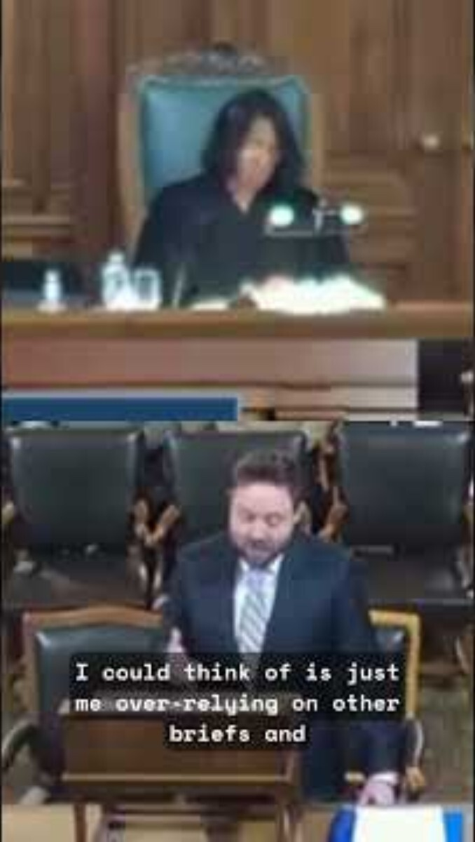
FROM THE COURTROOM
When the Bench Asks About AI
What to Watch For
Courts now ask whether AI was used — and whether counsel verified it.
Be ready to explain your tools, your review, and your sources.
Rule 3.3 candor applies the moment you rise to argue.
Oral argument, Atlanta (2026). Add the clip via Insert › Video to play it here. Independently verify any case discussed before relying on it.
AI in Legal Practice | Louisiana CLE
19

Slide 21
PUTTING IT TOGETHER
Your AI Compliance Checklist
Verify every citation
Protect client data
Independently confirm each case, quote, and statute before filing.
Use enterprise-grade tools; never feed privileged data into public AI.
Adopt a written policy
Supervise AI use
Define approved tools, disclosure, and a citation-verification log.
Train staff; apply Rules 5.1 & 5.3 to every nonlawyer assistant.
Check the court’s rules
Stay competent
Review each judge’s standing order on AI disclosure or certification.
Keep current on AI’s risks and benefits — a Rule 1.1 duty.
AI in Legal Practice | Louisiana CLE
20

Slide 22
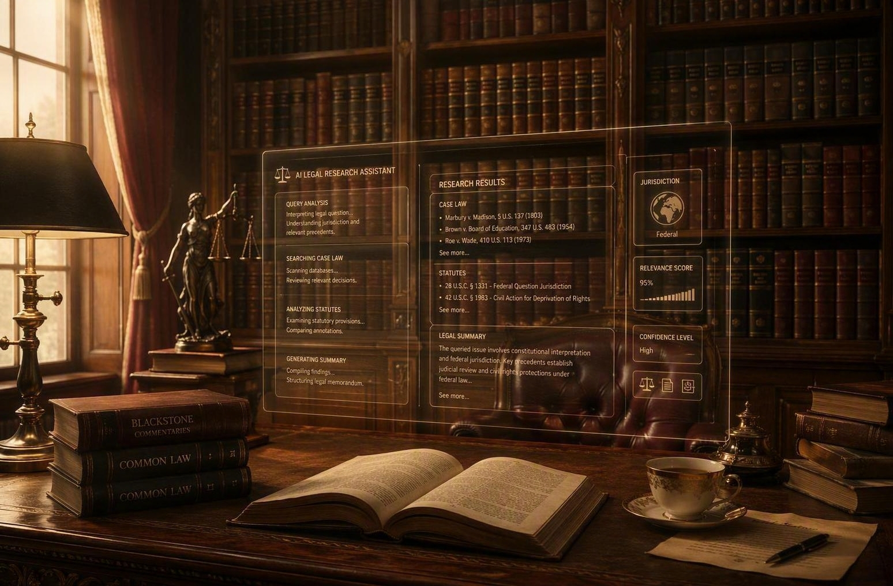
KEY TAKEAWAYS
Competence Now Includes AI
AI is a powerful assistant — but it hallucinates, and you stay responsible.
The existing Rules of Professional Conduct already govern its use.
Louisiana has codified diligence duties through Act 250.
Protect confidentiality; verify every citation; supervise the tool.
When in doubt, do not trust until verified.
Thank you — questions welcome.

